Slide 1

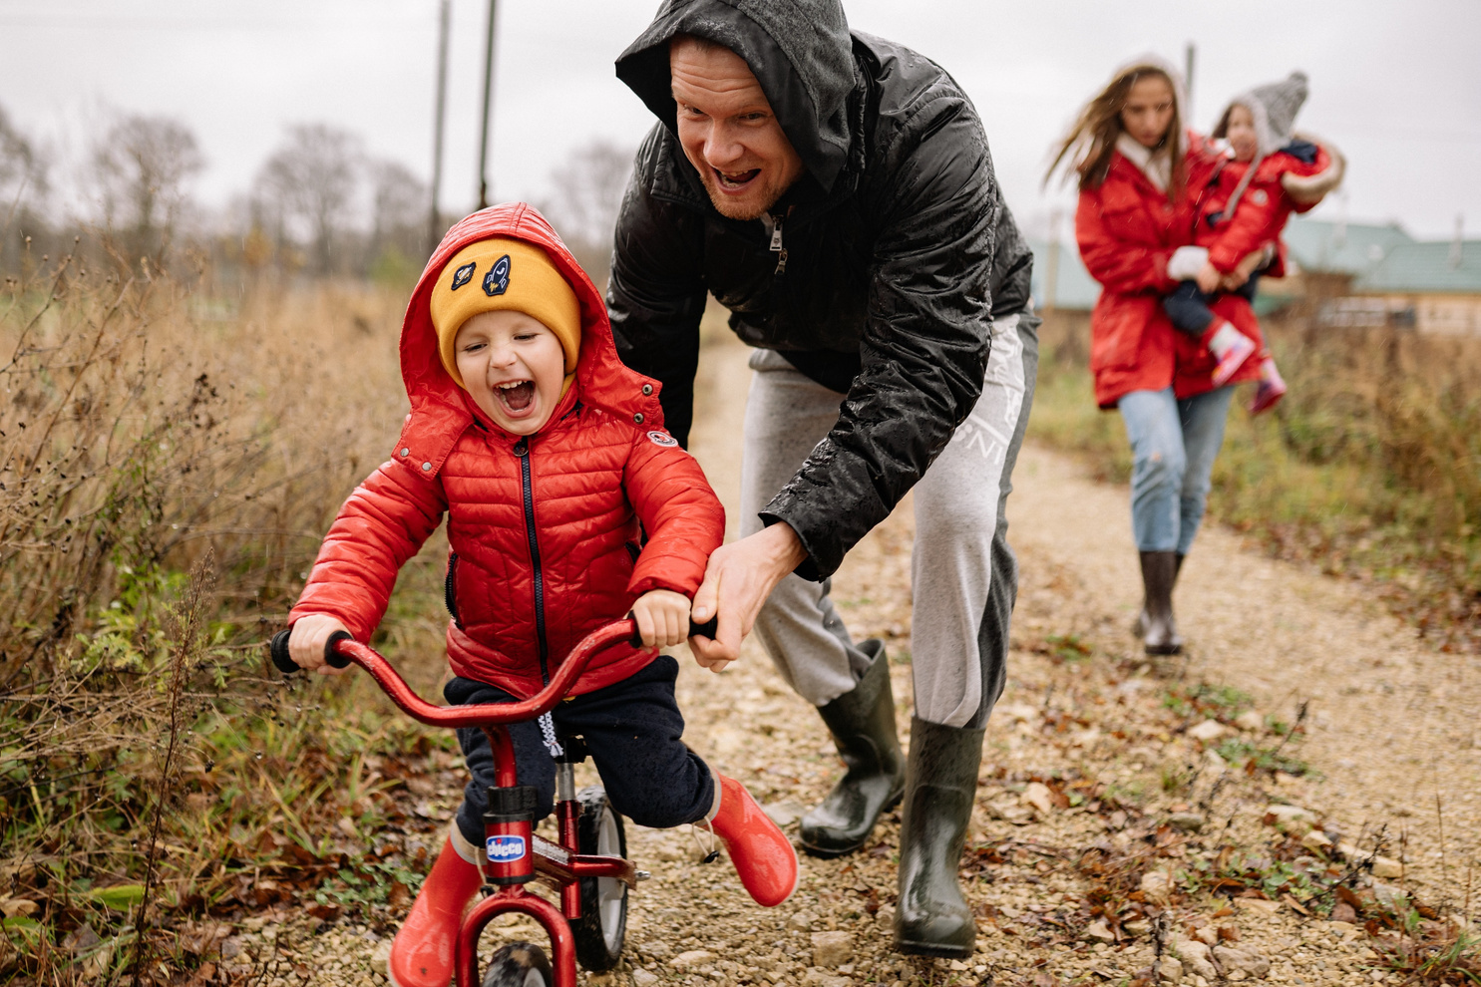




Slide 2

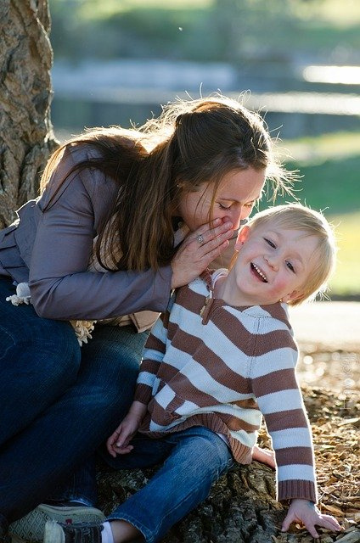

Chat
Key messages
  Talk to your baby and respond to their sounds, movement, and facial expressions. They love it when you copy them!
  Enjoy back-and-forth conversations with your child. Listen to what they say and respond.
  Pick up on comments your child makes about things they notice, their memories, and feelings.
Notes:
Tip: The 3 key messages to 'pass on' that relate to the suggested videos can be found in the Champions Workshop booklet along with the video links for Champions to share:
We want to help parent's to hear these key messages:
•Talk to your baby and respond to their sounds, movement, and facial expressions. They love it when you copy them!
•Enjoy back-and-forth conversations with your child. Listen to what they say and respond.
•Pick up on comments your child makes about things they notice, their memories, and their feelings.
The points below go through all the above key messages:
o Child not talking - comment, label, narrate
o Child talking – Repeat, extend

Slide 3


Remember these skills when chatting with little ones:
Talk
Pause
Listen
Respond
Notes:
Introduce the Chat Postcard with the basic skills for Chat that we want to see being passed on!

Slide 4


Play
Key messages
  Play is a great way to provide fun opportunities to talk about what interests your child.
  Try setting up a shop using tins and packets from the cupboard and enjoy role-playing together.
  Your child might enjoy simple dressing-up outfits which can be made using a tea towel for a cape or a cereal box for a mask to make up stories together.
Notes:
Tip: The 3 key messages to 'pass on' that relate to the suggested videos can be found in the Champions Workshop booklet along with the video links for Champions to share:
We want to help parent's to hear these key messages:
•Play is a great way to provide fun opportunities to talk about what interests
your child.
•Try setting up a shop using tins and packets from the cupboard and enjoy
role-playing together.
•Your child might enjoy simple dressing-up outfits which can be made using
a tea towel for a cape or a cereal box for a mask to make up stories together.

Slide 5

Remember this when playing with little ones:
Bring the play into everyday.
Notes:
Introduce the Play Postcard with the basic skills for Play that we want to see being passed on!

Slide 6


Read
Key messages
  Sharing books together can be a special time each day.
  Find books in the library or charity shop. Let your child choose what interests them.
  Look at the book together. Let your child ask questions and talk about the pictures while you read the story.
Notes:
Tip: The 3 key messages to 'pass on' that relate to the suggested videos can be found in the Champions Workshop booklet along with the video links for Champions to share:
We want to help parent's to hear these key messages:
•Sharing books together can be a special time each day.
•Find books in the library or charity shop. Let your child choose what interests
them.
•Look at the book together. Let your child ask questions and talk about the
pictures while you read the story.

Slide 7

Remember to have fun when reading with little ones:
Share books.
Share words.
Share everywhere.
Notes:
Introduce the Read postcard with the basic skills for Read that we want to see being passed on!

